Slide 1


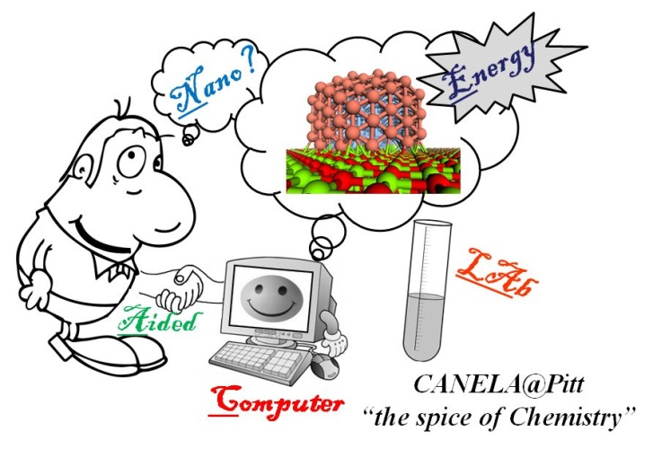
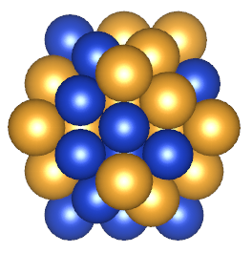
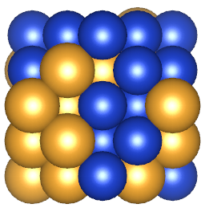
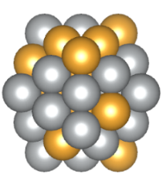
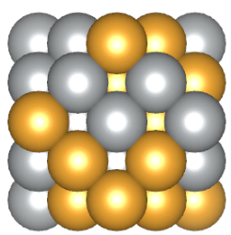
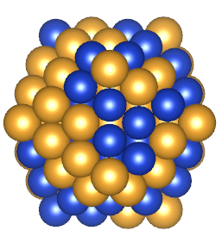
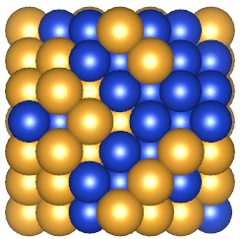
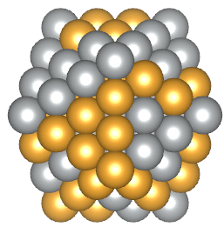
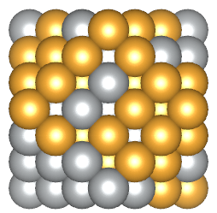




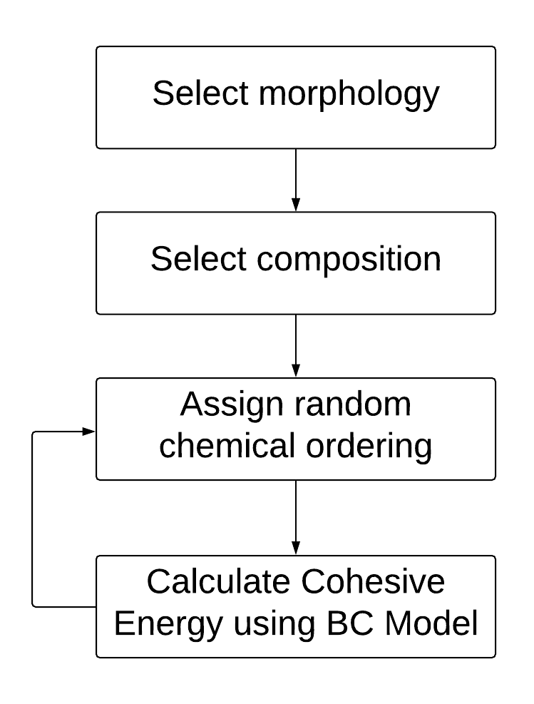
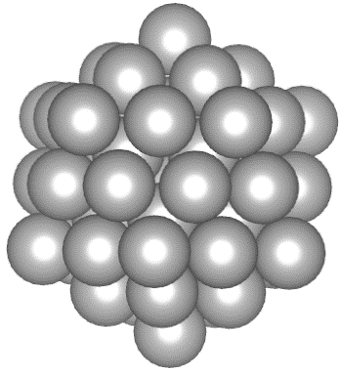
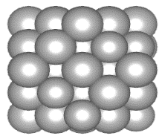
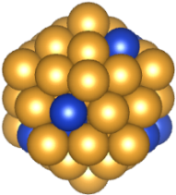
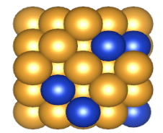

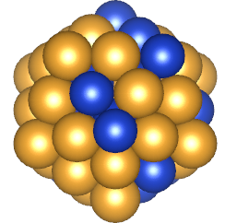
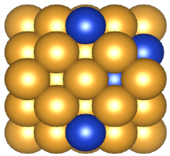
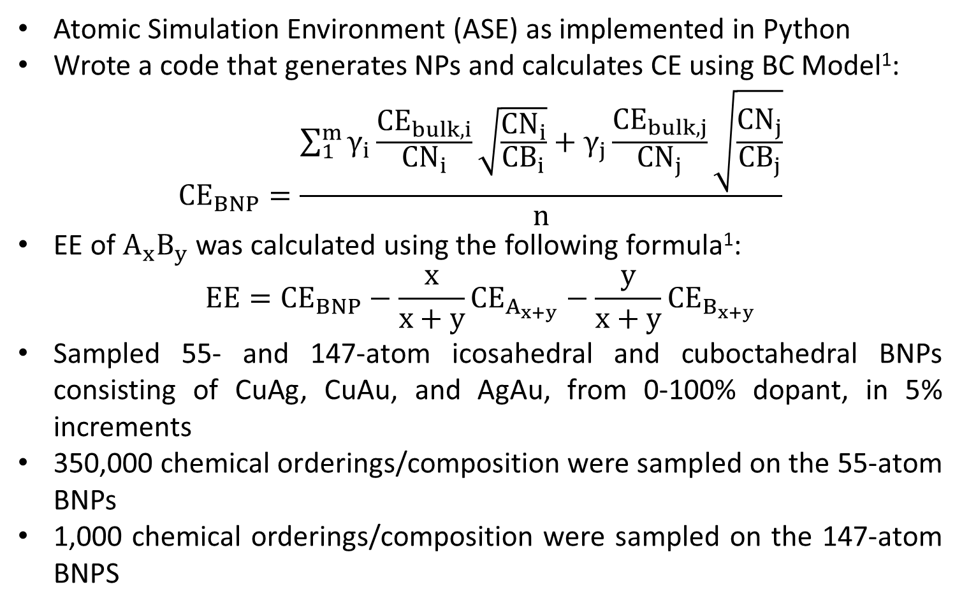
Investigation of Stability Trends in Bimetallic CuAg, CuAu, and AgAu Nanoparticles via Bond-Centric Model
Mpourmpakis Lab:
Mahmoud Ramadan, Jonathan Estes, James Dean, and Giannis Mpourmpakis
Department of Chemical Engineering, University of Pittsburgh, Pittsburgh, PA 15261
ABSTRACT
RESULTS
RESULTS
Metal nanoparticles (NPs) have attracted tremendous scientific interest over the last several decades due to their diverse technological applications, among which is catalysis. Compared to monometallic NPs, bimetallic NPs allow for a greater variation of local chemical environments and thus, control of potential catalytic sites. However, this local site variation also results in a significantly larger search space when investigating NPs of even the same bimetallic nanoparticle composition, size, and shape. Using a previously developed bond-centric (BC) model¹ as a means to calculate computationally fast a NP’s cohesive energy, a code was developed to efficiently determine potential ground-state structures for any given bimetallic NP. The cohesive energy was determined for 55- and 147-atom icosahedral and cuboctahedral NPs, consisting of CuAg, CuAu, and AgAu ranging from 0-100% in metal composition. At each given composition and morphology, atomic identities within the NP are shuffled several thousand times, calculating the cohesive energy for each sampled microstate.
Cohesive Energy (Metal Binding)
Au atom
Cu atom
Ag atom
Average CE decreases (more exothermic) as the Cu composition increases in CuAg BNPs
Minimum-energy structures of the 55- and 147-atom cuboctahedral and icosahedral 50/50 CuAu and 50/50 AgAu BNPs
BACKGROUND AND AIMS
SUMMARY
Nanoparticles have numerous applications in electronics², optics², catalysis³, and medicine⁴
Bimetallic NPs (BNPs) allow for more diverse chemical properties potentially leading to enhanced catalytic activity⁵
Cohesive Energy (CE) is a measure of NP stability
Density Functional Theory (DFT) calculations are accurate but computationally expensive to calculate CE
Excess Energy (EE) allows for comparison of NPs of different composition
Previously-developed BC model¹ can efficiently calculate CE of BNPs
Aims:
Investigate the composition and morphology of BNPs using Monte Carlo sampling in conjunction with BC model¹ to calculate CE
Determine preferred chemical ordering in BNPs
Overall: Identify most thermodynamically stable BNPs
Investigated BNP stability by calculating CE and EE using a previously developed BC model ¹
Compared different chemical orderings within the same composition
Identified the favorable formation of 55- and 147-atom icosahedral and cuboctahedral CuAu and AgAu BNPs
Future Work: Incorporate symmetry operations to simulate BNPs of larger size
Average CE increases (less exothermic) as the Ag composition increases in AgAu BNPs
REFERENCES
1. Yan, Z.; Taylor, M.; Mascareno, A.; Mpourmpakis, G. Size-, Shape-, and Composition-Dependent Model for Metal Nanoparticle Stability Prediction. Nano Letters 2018, 18 (4), 2696-2704.
2. Kelly, K. L.; Coronado, E.; Zhao, L. L.; Schatz, G. C. The optical properties of metal nanoparticles: The influence of size, shape, and dielectric environment. J. Phys. Chem. B 2003, 107 (3), 668−677.
3. Austin, N.; Ye, J.; Mpourmpakis, G. CO₂ activation on Cu-based Zr- decorated nanoparticles. Catal. Sci. & Technol. 2017, 7, 2245-2251.
4. Murthy, S. K. Nanoparticles in modern medicine: State of the art and future challenges. Int. J. Nanomed. 2007, 2 (2), 129-139.
5. Dean, J.; Yang, Y.; Austin, N.; Veser, G.; Mpourmpakis, G. Designing Cu-based Bimetallic Nanoparticles for CO₂ Adsorption and Activation. ChemSusChem. 2018, 11(7), 1169-1178.
METHODS
Atomic Simulation Environment (ASE) as implemented in Python
Wrote a code that generates NPs and calculates CE using BC Model¹:
$${CE}_{BNP}=\frac{\sum_{1}^{m}{γ_{i}}\frac{{CE}_{bulk,i}}{{CN}_{i}}\sqrt{\frac{{CN}_{i}}{{CB}_{i}}}+γ_{j}\frac{{CE}_{bulk,j}}{{CN}_{j}}\sqrt{\frac{{CN}_{j}}{{CB}_{j}}}}{n}$$
EE of $A_{x}B_{y}$ was calculated using the following formula¹:
$$EE={CE}_{BNP}−\frac{x}{x+y}{CE}_{A_{x+y}}−\frac{y}{x+y}{CE}_{B_{x+y}}$$
Sampled 55- and 147-atom icosahedral and cuboctahedral BNPs consisting of CuAg, CuAu, and AgAu, from 0-100% dopant, in 5% increments
350,000 chemical orderings/composition were sampled on the 55-atom BNPs
1,000 chemical orderings/composition were sampled on the 147-atom BNPS
Average CE increases (less exothermic) as the Cu composition increases in CuAu BNPs
Excess Energy (Metal Mixing)
ACKNOWLEGEMENTS
The authors extend thanks to Dr. Michail Stamatakis from University College London, UK, for fruitful discussions
Grant Number CMMI-1634880
Grant Number ECC-1659324
Suggests that Cu and Ag do not form 55- or 147-atom icosahedral/cuboctahedral BNPs
Suggests the favorable formation of 55- and 147-atom CuAu and AgAu icosahedral/cuboctahedral BNPs tending towards 50% elemental composition

